Slide 1
CSE7302 - INTERNSHIP
Review-2 Presentation
Real-Time Fixed Deposit Viewer Platform (FinTechora)
Student Details
Name | DHANUSH GOWDA B U
Roll No | 20221CSE0522
Section | 8CSE03
Under the Supervision of,
        Dr.Megala G
        Assistant Professor
        Presidency School of CSE
        Presidency University
Name of the Program: B.Tech – Computer Science & Engineering
Name of the HoD: Dr. Blessed Prince P
Name of the Program Internship Coordinator: Ms. Riya Sanjesh
Name of the School Internship Coordinator: Dr. Md Ziaur Rahman

Slide 2
About Company or Organization
BNP Paribas is a global banking organization
Headquartered in Paris, France
Operates in multiple countries
Provides banking and financial services

Slide 3
Working domain or the technology
MERN Stack Development
MongoDB for database
Express and Node.js backend
React for frontend dashboard
REST API based communication

Slide 4
About your team and reporting Manager
Working in development team
Assigned to fixed deposit module
Guided by reporting mentor
Regular task reviews

Slide 5
Challenges Faced in Internship
Understanding existing project flow
Learning finance domain basics
Handling real-time data
Following coding standards

Slide 6
Objectives of the work
Develop real-time FD viewer platform
Show live FD value growth
Help users track invested money
Improve MERN stack skills

Slide 7
Literature Review
Studied fixed deposit systems
Reviewed finance dashboards
Observed real-time tracking platforms

Slide 8
Proposed System / Work
Real-time fixed deposit viewer platform
User can view active deposits
Shows invested and maturity values
Tracks money growth over time

Slide 9
Problem Statement
Users cannot track FD growth easily
No real-time FD view
Data scattered across platforms
Need a single tracking dashboard

Slide 10
System Requirements
MongoDB database
Node.js and Express backend
React frontend
REST APIs
Web browser

Slide 11
Advantages of Proposed System/Work
Real-time FD tracking
Clear money growth view
Easy portfolio monitoring
User-friendly dashboard

Slide 12
Internship Road Map
Note: Write in the below table what u will be achieving in each review
Review 1
Domain learning and setup
Review 2
FD dashboard development
Review 3
Backend API integration
Review 4
Final Review
Testing and refinement
Complete system delivery

Slide 13
Github Link
https://github.com/dhanushbu2004/CSE7302-Internship

Slide 14
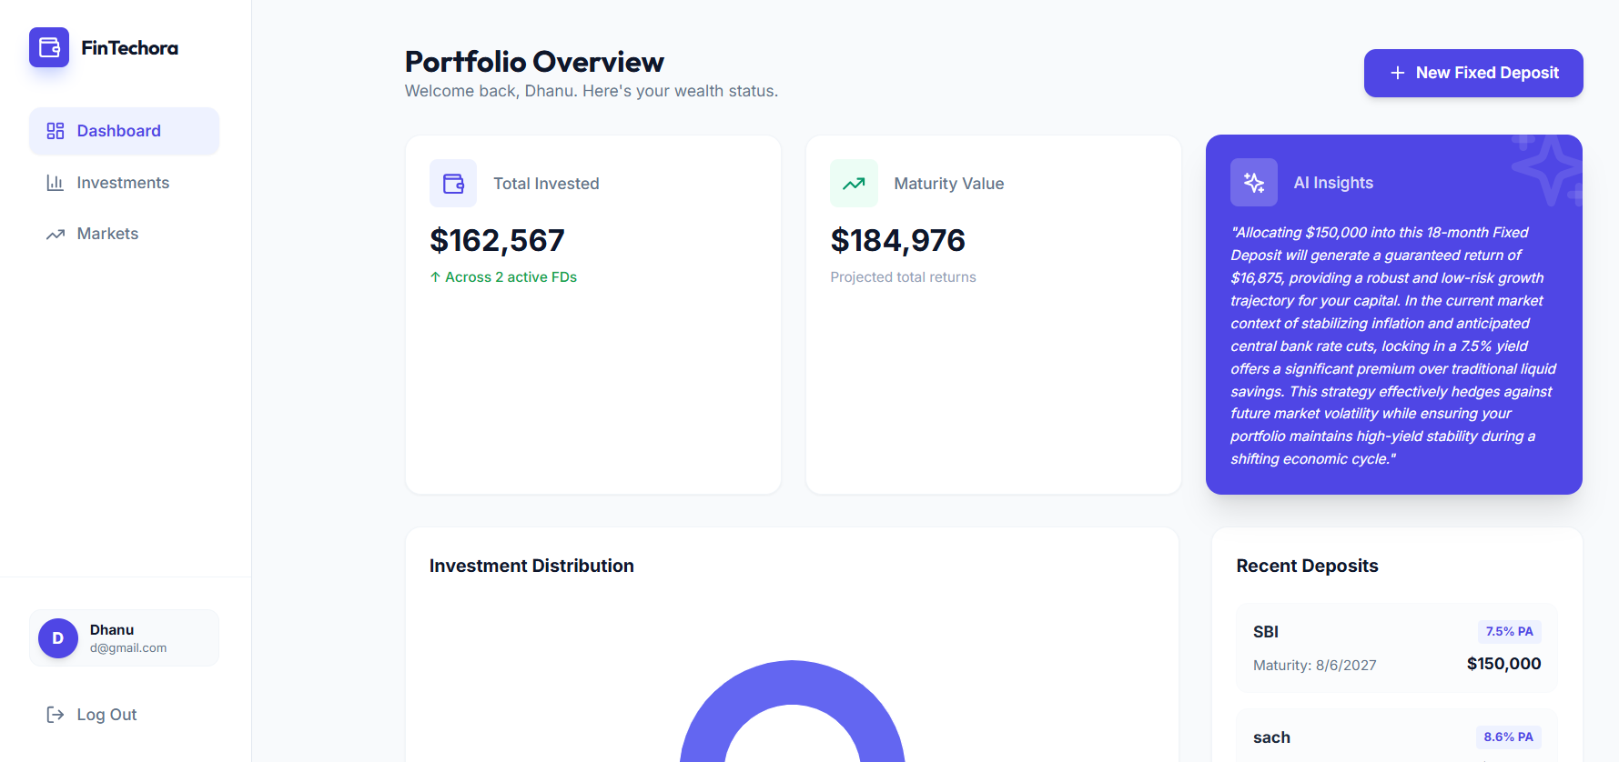

Slide 15
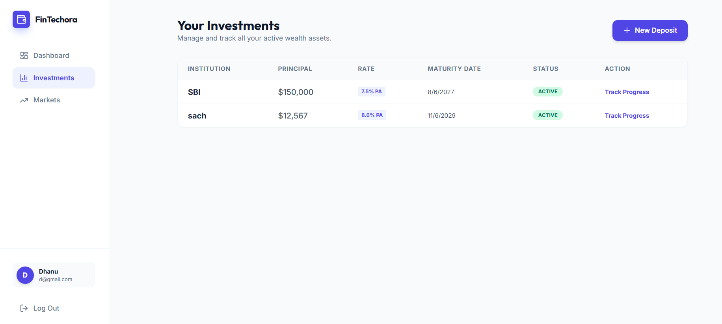

Slide 16
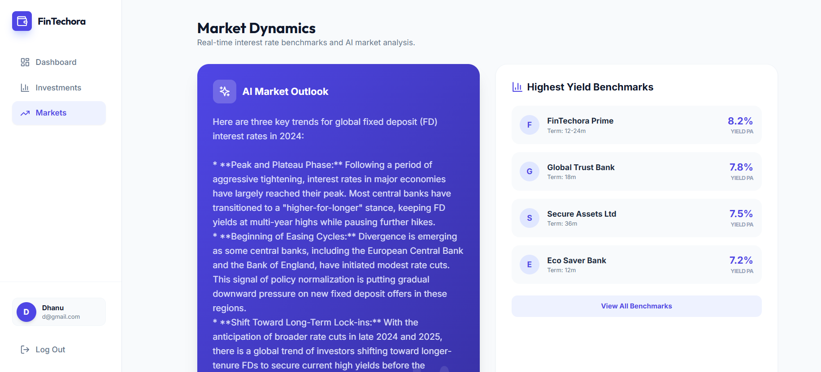

Slide 17
Q&A

Slide 18
Thank you !!

